Slide 1
Public-Key Encryption and Digital Signatures
CS 161 Fall 2023 - Lecture 11

Slide 2
PRNGs: Summary
True randomness requires sampling a physical process
Slow, expensive, and biased (low entropy)
PRNG: An algorithm that uses a little bit of true randomness to generate a lot of random-looking output
Seed(entropy): Initialize internal state
Reseed(entropy): Add additional entropy to the internal state
Generate(n): Generate n bits of pseudorandom output
Security: Computationally indistinguishable from truly random bits
HMAC-DRBG: Use repeated applications of HMAC to generate pseudorandom bits
Application: UUIDs

Slide 3
Summary: Diffie-Hellman Key Exchange
Algorithm:
Alice chooses a and sends gª mod p to Bob
Bob chooses b and sends g^{b} mod p to Alice
Their shared secret is (gª)^{b} = (g^{b})ª = g^{ab} mod p
Diffie-Hellman provides forwards secrecy: Nothing is saved or can be recorded that can ever recover the key
Diffie-Hellman can be performed over other mathematical groups, such as elliptic-curve Diffie-Hellman (ECDH)
Issues
Not secure against MITM
Both parties must be online
Does not provide authenticity

Slide 4
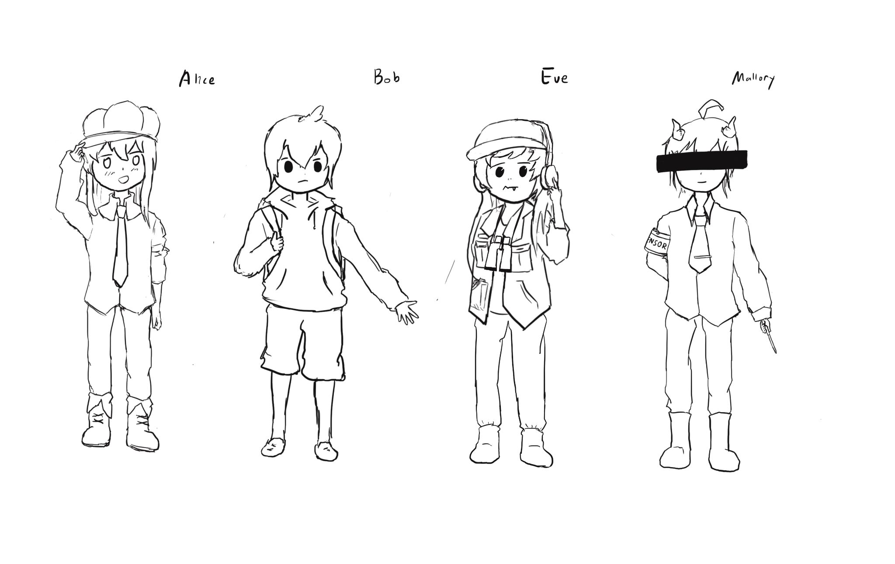
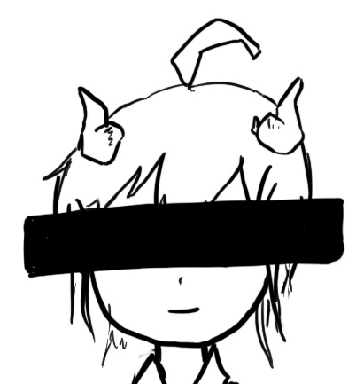
Diffie-Hellman: Security
Alice
Mallory
Public: g, p
Bob
Generate a
Calculate gª mod p
Receive g^{m} mod p
Calculate (g^{m})ª mod p
Generate m
Calculate g^{m} mod p
Generate b
Calculate g^{b} mod p
Receive g^{m} mod p
Calculate (g^{m})^{b} mod p
Receive gª mod p
Calculate (gª)^{m} mod p
Receive g^{b} mod p
Calculate (g^{b})^{m} mod p
a, gª, g^{m} ⇒ g^{am}
m, g^{m}, gª ⇒ g^{am}
m, g^{m}, g^{b} ⇒ g^{bm}
b, g^{b}, g^{m} ⇒ g^{bm}

Slide 5

Public-Key Cryptography

Slide 6
Public-Key Cryptography
In public-key schemes, each person has two keys
Public key: Known to everybody
Private key: Only known by that person
Keys come in pairs: every public key corresponds to one private key
Uses number theory
Examples: Modular arithmetic, factoring, discrete logarithm problem
Contrast with symmetric-key cryptography (uses XORs and bit-shifts)
Messages are numbers
Contrast with symmetric-key cryptography (messages are bit strings)
Benefit: No longer need to assume that Alice and Bob already share a secret
Drawback: Much slower than symmetric-key cryptography
Number theory calculations are much slower than XORs and bit-shifts

Slide 7
Public-Key Encryption
Textbook Chapter 11

Slide 8



Public-Key Encryption
Everybody can encrypt with the public key
Only the recipient can decrypt with the private key

Slide 9
Public-Key Encryption: Definition
Three parts:
KeyGen() → PK, SK: Generate a public/private keypair, where PK is the public key, and SK is the private (secret) key
Enc(PK, M) → C: Encrypt a plaintext M using public key PK to produce ciphertext C
Dec(SK, C) → M: Decrypt a ciphertext C using secret key SK
Properties
Correctness: Decrypting a ciphertext should result in the message that was originally encrypted
Dec(SK, Enc(PK, M)) = M for all PK, SK ← KeyGen() and M
Efficiency: Encryption/decryption should be fast
Security: Similar to IND-CPA, but Alice (the challenger) just gives Eve (the adversary) the public key, and Eve doesn’t request encryptions, except for the pair M0, M1
You don’t need to worry about this game (it’s called “semantic security”)

Slide 10
RSA Encryption
Textbook Chapter 11.3

Slide 11
Cryptography Roadmap
 | Symmetric-key | Asymmetric-key
Confidentiality | One-time pads Block ciphers with chaining modes (e.g. AES-CBC) | RSA encryption ElGamal encryption
Integrity, Authentication | MACs (e.g. HMAC) | Digital signatures (e.g. RSA signatures)
Hash functions
Pseudorandom number generators
Public key exchange (e.g. Diffie-Hellman)
Key management (certificates)
Password management

Slide 12
RSA Encryption: Definition
KeyGen():
Randomly pick two large primes, p and q
Efficient algorithm: pick random numbers and then use a test to see if the number is prime
Compute N = pq
N is usually between 2048 bits and 4096 bits long
Choose e
Requirement: e is relatively prime to (p - 1)(q - 1)
Requirement: 2 < e < (p - 1)(q - 1)
Compute d = e⁻¹ mod (p - 1)(q - 1)
Efficient algorithm for computing multiplicative inverses: Extended Euclid’s algorithm
Public key: N and e
Private key: d
Notes:
All above steps can be done in time linear in the number of bits of N

Slide 13
RSA Encryption: Definition
From key generation:
N = pq
d = e⁻¹ mod (p - 1)(q - 1)
Enc(e, N, M):
Assume M < N
Output Me mod N
Dec(d, C):
Output C^{d} mod N
For correctness, we need: Dec(d, Enc(e, N, M)) = (Me)^{d} = M mod N

Slide 14
RSA Encryption: Correctness
Theorems we need:
From the Chinese Remainder Theorem: To check if x = y mod pq, we can check if x = y mod p, and x = y mod q
What we know from key generation:
N = pq
d = e⁻¹ mod (p - 1)(q - 1) Therefore, ed = 1 mod (p - 1)(q - 1) Therefore, ed - 1 is a multiple of (p - 1)(q - 1)
Goal (for correctness): M^{ed} = M mod N Using definition of N: M^{ed} = M mod pq We need to check if M^{ed} = M mod p and M^{ed} = M mod q

Slide 15
RSA Encryption: Correctness
Facts we need:
ed - 1 is a multiple of (p - 1)(q - 1). From definition of d and e during key generation.
a^{p-1} = 1 mod p, for any prime p. Fermat's Little Theorem.
Goal: M^{ed} = M mod p
Case 1: M is a multiple of p.
M = 0 mod p
M^{ed} = 0 mod p, because we're multiplying M (a multiple of p) a bunch of times.
Case 2: M is not a multiple of p.
M^{ed} = M^{ed-1} M (mod p) = M^{some multiple of p-1} M (mod p) (using definition of ed - 1) = M (mod p) (using FLT)

Slide 16
RSA Encryption: Correctness
Facts we need:
ed - 1 is a multiple of (p - 1)(q - 1). From definition of d and e during key generation.
a^{p-1} = 1 mod p, for any prime p. Fermat's Little Theorem.
Goal: M^{ed} = M mod q
Case 1: M is a multiple of q.
M = 0 mod q
M^{ed} = 0 mod q, because we're multiplying M (a multiple of q) a bunch of times.
Case 2: M is not a multiple of q.
M^{ed} = M^{ed-1} M (mod q) = M^{some multiple of q-1} M (mod q) (using definition of ed - 1) = M (mod q) (using FLT)

Slide 17
RSA Encryption: Correctness
Theorem: M^{ed} ≡ M mod N
Euler’s theorem: a^{φ(N)} ≡ 1 mod N
φ(N) is the totient function of N
If N is prime, φ(N) = N - 1 (Fermat’s little theorem)
For a semi-prime pq, where p and q are prime, φ(pq) = (p - 1)(q - 1)
Notice: ed ≡ 1 mod (p - 1)(q - 1) so ed ≡ 1 mod φ(N)
This means that ed = kφ(n) + 1 for some integer k
(1) can be written as M^{kφ(N) + 1} ≡ M mod N
M^{kφ(N)}M¹ ≡ M mod N
1M¹ ≡ M mod N by Euler’s theorem
M ≡ M mod N
Notes:
Older version of the slide, using Euler's theorem to prove correctness (as opposed to Fermat's little theorem)

Slide 18
RSA Encryption: Security
RSA problem: Given N and C = Me mod N, it is hard to find M
No harder than the factoring problem: If you can factor N, you can learn p and q. Then, you can compute d = e⁻¹ mod (p - 1)(q - 1) and decrypt with C^{d} mod N.
Current best solution is to factor N, but unknown whether there is an easier way
If the RSA problem is as hard as the factoring problem, then the scheme is secure as long as the factoring problem is hard
Factoring problem is assumed to be hard. Best known algorithms are exponential-time

Slide 19
RSA Encryption: Issues
Is RSA encryption IND-CPA secure?
No. It’s deterministic. No randomness was used at any point!
Sending the same message encrypted with different public keys also leaks information
m^{ea} mod Na, m^{eb} mod nb, m^{ec} mod Nc
Small m and e leaks information
e is usually small (~16 bits) and often constant (3, 17, 65537)
Side channel: A poor implementation leaks information
The time it takes to decrypt a message depends on the message and the private key
This attack has been successfully used to break RSA encryption in OpenSSL
Result: We need a probabilistic padding scheme

Slide 20
OAEP
Optimal asymmetric encryption padding (OAEP): A variation of RSA that introduces randomness
Different from “padding” used for symmetric encryption, used to add randomness instead of dummy bytes
Idea: RSA can only encrypt “random-looking” numbers, so encrypt the message with a random key
Notes:
Nick says this is a random key, but it’s really a fixed key (and a random input as part of the input to the fixed Feistel network)

Slide 21
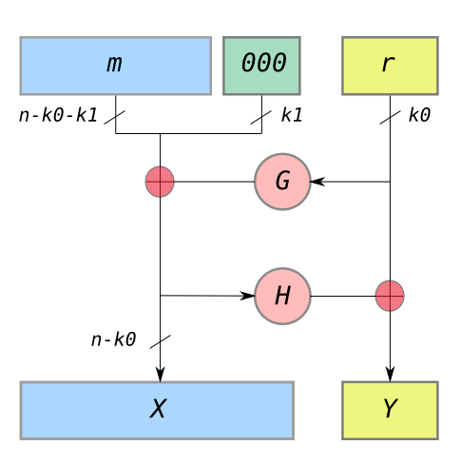
OAEP: Padding
k0 and k1 constants defined in the standard, and G and H are hash functions
M can only be n - k0 - k1 bits long
G produces a (n - k0)-bit hash, and H produces a k0-bit hash
Pad M with k0 0’s
Idea: We should see 0’s here when unpadding, or else someone tampered with the message
Generate a random, k1-bit string r
Compute X = M || 00...0 ⊕ G(r)
Compute Y = r ⊕ H(X)
Result: X || Y

Slide 22
OAEP: Unpadding
Compute r = Y ⊕ H(X)
Compute M || 00...0 = X ⊕ G(r)
Verify that M || 00...0 actually ends in k1 0’s
Error if not

Slide 23
OAEP
Even though G and H are irreversible, we can recover their inputs using XOR and work backwards
This structure is called a Feistel network
Can be used for encryption algorithms if G and H depend on a key
Example: DES (out of scope)
Takeaway: To fix the problems with RSA (it’s only secure encrypting random numbers and isn’t IND-CPA), use RSA with OAEP, abbreviated as RSA-OAEP

Slide 24
Hybrid Encryption
Issues with public-key encryption
Notice: We can only encrypt small messages because of the modulo operator
Notice: There is a lot of math, and computers are slow at math
Result: Asymmetric doesn’t work for large messages
Hybrid encryption: Encrypt data under a randomly generated key K using symmetric encryption, and encrypt K using asymmetric encryption
Benefit: Now we can encrypt large amounts of data quickly using symmetric encryption, and we still have the security of asymmetric encryption
Almost all cryptographic systems use hybrid encryption
Notes:
Ask after presenting issues: Ideas for how to encrypt large messages efficiently?

Slide 25
ElGamal Encryption
Textbook Chapter 11.4

Slide 26
Cryptography Roadmap
 | Symmetric-key | Asymmetric-key
Confidentiality | One-time pads Block ciphers with chaining modes (e.g. AES-CBC) | RSA encryption ElGamal encryption
Integrity, Authentication | MACs (e.g. HMAC) | Digital signatures (e.g. RSA signatures)
Hash functions
Pseudorandom number generators
Public key exchange (e.g. Diffie-Hellman)
Key management (certificates)
Password management

Slide 27
ElGamal Encryption
Diffie-Hellman key exchange is great: It lets Alice and Bob share a secret over an insecure channel
Problem: Diffie-Hellman by itself can’t send messages. The secret g^{ab} mod p is random.
Idea: Let’s modify Diffie-Hellman so it supports encrypting and decrypting messages directly

Slide 28
ElGamal Encryption: Protocol
KeyGen():
Bob generates private key b and public key B = g^{b} mod p
Intuition: Bob is completing his half of the Diffie-Hellman exchange
Enc(B, M):
Alice generates a random r and computes R = g^{r} mod p
Intuition: Alice is completing her half of the Diffie-Hellman exchange
Alice computes M × B^{r} mod p
Intuition: Alice derives the shared secret and multiples her message by the secret
Alice sends C1 = R, C2 = M × B^{r} mod p
Dec(b, C1, C2)
Bob computes C2 × C1^{-b} = M × B^{r} × R^{-b} = M × g^{br} × g^{-br} = M mod p
Intuition: Bob derives the (inverse) shared secret and multiples the ciphertext by the inverse shared secret

Slide 29
ElGamal Encryption: Security
Recall Diffie-Hellman problem: Given gª mod p and g^{b} mod p, hard to recover g^{ab} mod p
ElGamal sends these values over the insecure channel
Bob’s public key: B
Ciphertext: R, M × B^{r} mod p
Eve can’t derive g^{br}, so she can’t recover M

Slide 30
ElGamal Encryption: Issues
Is ElGamal encryption IND-CPA secure?
No. The adversary can send M0 = 0, M1 ≠ 0
Additional padding and other modifications are needed to make it semantically secure
Malleability: The adversary can tamper with the message
The adversary can manipulate C1’ = C1, C2’ = 2 × C2 = 2 × M × g^{br} to make it look like 2 × M was encrypted

Slide 31

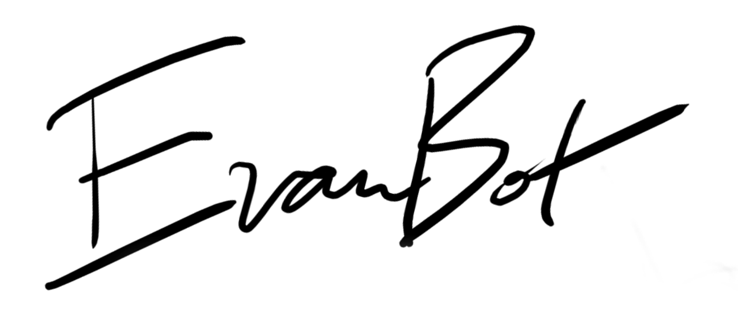
Digital Signatures
Textbook Chapter 12

Slide 32
Cryptography Roadmap
 | Symmetric-key | Asymmetric-key
Confidentiality | One-time pads Block ciphers with chaining modes (e.g. AES-CBC) | RSA encryption ElGamal encryption
Integrity, Authentication | MACs (e.g. HMAC) | Digital signatures (e.g. RSA signatures)
Hash functions
Pseudorandom number generators
Public key exchange (e.g. Diffie-Hellman)
Key management (certificates)
Password management

Slide 33
Digital Signatures
Asymmetric cryptography is good because we don’t need to share a secret key
Digital signatures are the asymmetric way of providing integrity/authenticity to data
Assume that Alice and Bob can communicate public keys without Mallory interfering
We will see how to fix this limitation later

Slide 34



Public-key Signatures
Only the owner of the private key can sign messages with the private key
Everybody can verify the signature with the public key

Slide 35
Digital Signatures: Definition
Three parts:
KeyGen() → PK, SK: Generate a public/private keypair, where PK is the verify (public) key, and SK is the signing (secret) key
Sign(SK, M) → sig: Sign the message M using the signing key SK to produce the signature sig
Verify(PK, M, sig) → {0, 1}: Verify the signature sig on message M using the verify key PK and output 1 if valid and 0 if invalid
Properties
Correctness: Verification should be successful for a signature generated over any message
Verify(PK, M, Sign(SK, M)) = 1 for all PK, SK ← KeyGen() and M
Efficiency: Signing/verifying should be fast
Security: EU-CPA, same as for MACs

Slide 36
Digital Signatures in Practice
If you want to sign message M:
First hash M
Then sign H(M)
Why do digital signatures use a hash?
Allows signing arbitrarily long messages
Digital signatures provide integrity and authenticity for M
The digital signature acts as proof that the private key holder signed H(M), so you know that M is authentically endorsed by the private key holder

Slide 37
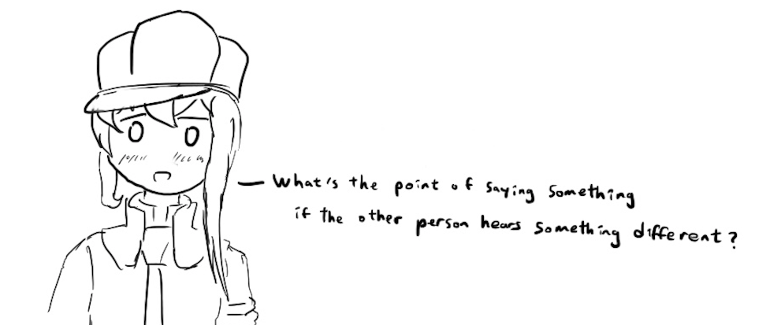
RSA Signatures
Textbook Chapter 12

Slide 38
RSA Signatures
Recall RSA encryption: M^{ed} ≡ M mod N
There is nothing special about using e first or using d first!
If we encrypt using d, then anyone can “decrypt” using e
Given x and x^{d} mod N, can’t recover d because of discrete-log problem, so d is safe

Slide 39
RSA Signatures: Definition
KeyGen():
Same as RSA encryption:
Public key: N and e
Private key: d
Sign(d, M):
Compute H(M)^{d} mod N
Verify(e, N, M, sig)
Verify that H(M) ≡ sig^{e} mod N

Slide 40
RSA Signatures: Definition
Recall RSA encryption: M^{ed} ≡ M mod N
There is nothing special about using e first or using d first!
If we encrypt using d, then anyone can “decrypt” using e
Given x and x^{d} mod N, can’t recover d because of discrete-log problem, so d is safe

Slide 41
DSA Signatures

Slide 42
DSA Signatures
A signature scheme based on Diffie-Hellman
The details of the algorithm are out of scope
Usage
Alice generates a public-private key pair and publishes her public key
To sign a message, Alice generates a random, secret value k and does some computation
Note: k is not Alice’s private key
Note: k is sometimes called a nonce but it is not: it must be random and never reused
The signature itself does not include k!
k must be random and secret for each message
An attacker who learns k can also learn Alice’s private key
If Alice reuses k on two signatures, an attacker can learn k (and use k to learn her private key)
Notes:
https://rdist.root.org/2009/05/17/the-debian-pgp-disaster-that-almost-was/
https://rdist.root.org/2010/11/19/dsa-requirements-for-random-k-value/

Slide 43
DSA Signatures: Attacks
Sony PlayStation 3 (PS3)
Digital rights management (DRM)
Prevent unauthorized code (e.g. pirated software) from running
The PS3 was designed to only run signed code
Signature algorithm: Elliptic-curve DSA
Running alternate operating systems
The PS3 had an option to run alternate operating systems (Linux) that was later removed
This was catnip to reverse engineers (“The best way to get people interested is removing Linux from a device”)
One of the authentication keys used to sign the firmware reused k for multiple signatures → security lost!

Slide 44
DSA Signatures: Attacks
Android OS vulnerability (2013)
The "SecureRandom" function in its random number generator (RNG) wasn’t actually secure!
Not only was it low entropy, it would sometimes return the same value multiple times
Multiple Bitcoin wallet apps on Android were affected
Bitcoin payments are signed with elliptic-curve DSA and published publicly
Insecure RNG caused multiple payments to be signed with the same k
Attack: Someone scanned for all Bitcoin transactions signed insecurely
Recall: When multiple signatures use the same k, the attacker can learn k and the private key
In Bitcoin, your private key unlocks access to all your money

Slide 45
DSA Signatures: Attacks
Chromebooks have a built-in U2F (universal second factor) security key
Uses signatures to let the user log in to particular websites
Signature algorithm: 256-bit elliptic-curve DSA
There was a bug in the secure hardware!
Instead of using 256-bit k, a bug caused k to be 32 bits long!
An attacker with a signature could simply try all possible values of k
Fortunately the damage was slight
Each signature is only valid for logging into a single website
Each website used its own private key
Takeaway: DSA (or ECDSA) is particularly vulnerable to incorrect implementations, compared with RSA signatures
Notes:
https://www.chromium.org/chromium-os/u2f-ecdsa-vulnerability

Slide 46
Summary: Public-Key Cryptography
Public-key cryptography: Two keys; one undoes the other
Public-key encryption: One key encrypts, the other decrypts
Security properties similar to symmetric encryption
ElGamal: Based on Diffie-Hellman
The public key is g^{b}, and C1 is g^{r}.
Not IND-CPA secure on its own
RSA: Produce a pair e and d such that M^{ed} = M mod N
Not IND-CPA secure on its own
Hybrid encryption: Encrypt a symmetric key, and use the symmetric key to encrypt the message
Digital signatures: Integrity and authenticity for asymmetric schemes
RSA: Same as RSA encryption, but encrypt the hash with the private key

